Slide 1
Weakly Supervised Learning of Rigid 3D Scene Flow
Presented By: Rafid Abyaad and Wenliang Peng
Supervised By : Yujin Chen

Slide 2
Outline
Recap
Areas of Improvement
Implementations
Experimental results

Slide 3
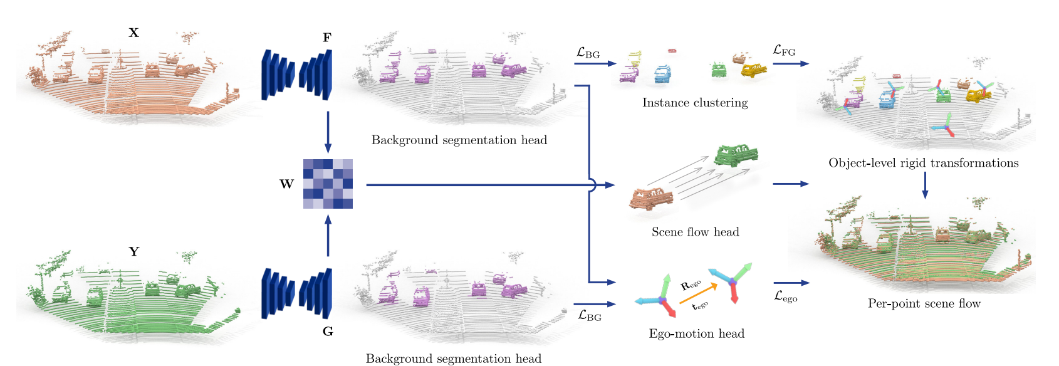
Recap

Slide 4
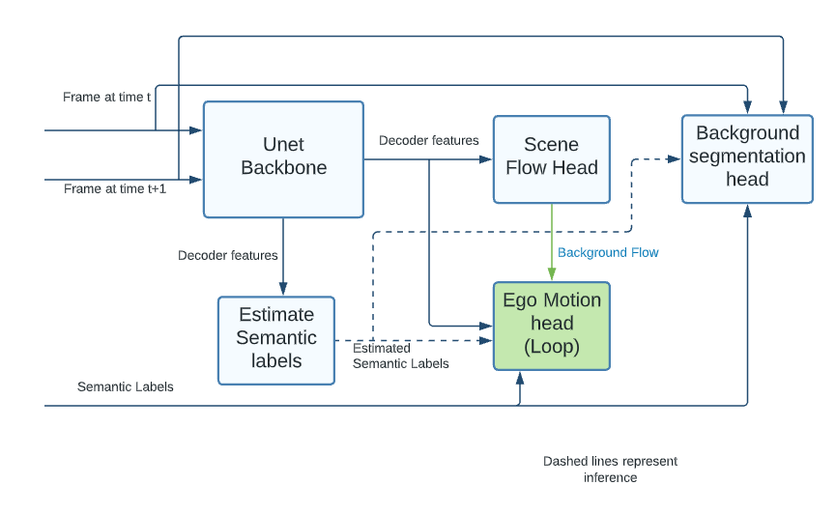
Model overview

Slide 5
Areas of improvements
Ego-motion and flow calculation
Ego-motion finds transformations for background points of X w.r.t. Y.
Flow finds transformations for clustered foreground points of X w.r.t. Y.
Background flow
Flow is only used to supervise foreground clusters.
Segmentation loss functions
BG-FG segmentation uses cross entropy loss.
CE loss is sensitive to class imbalance.

Slide 6
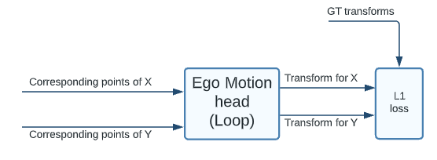
Implementation 1 : Ego-flow loop
Ego-motion estimation :
Find transformation for Y w.r.t. X as well as for X w.r.t. Y.
Calculate losses for both and use the mean.
Justification :
Rigid body transformation allow us to perform an inverse transformation.
Averaging makes the transforms more robust.

Slide 7
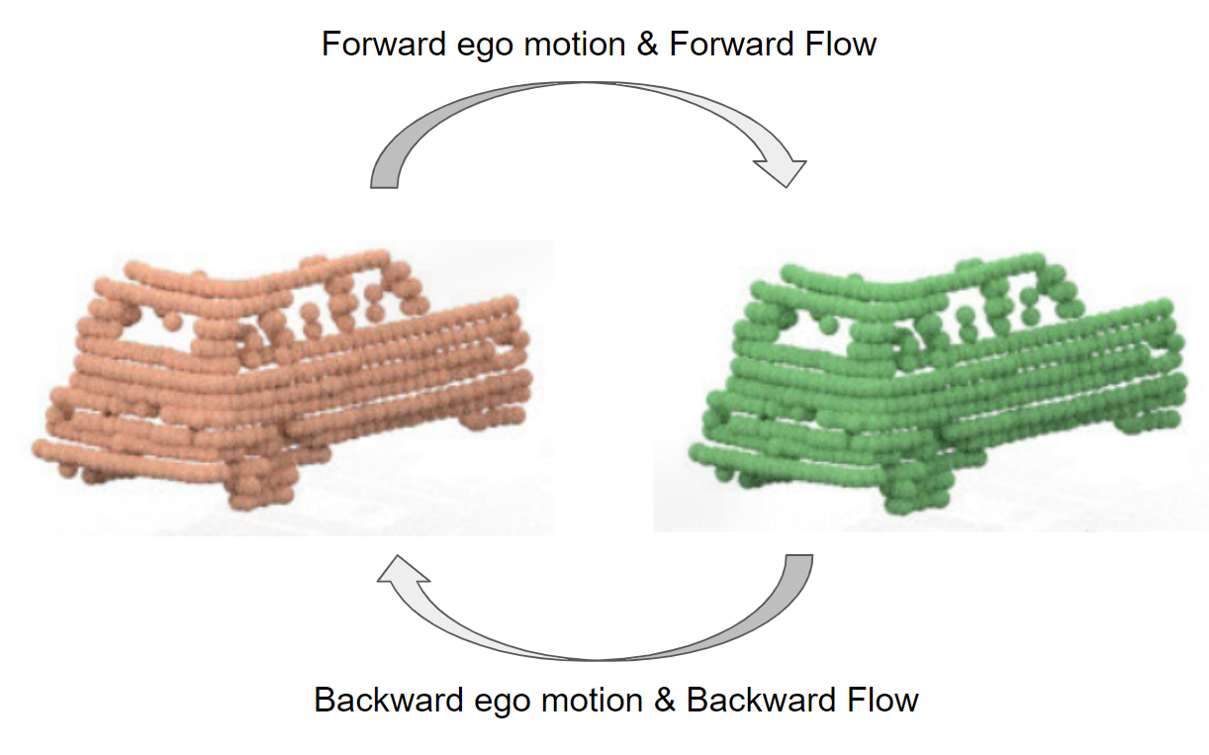
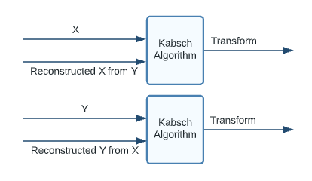
Implementation 1 : Ego-flow loop (contd.)
Flow estimation :
Find flow for clusters in Y w.r.t. X as well as for X w.r.t. Y.
Use the mean L1 loss as rigidity loss.
Justification :
The extracted features have no ordered relationship.
Flow is not obtained from the sequential relation.

Slide 8
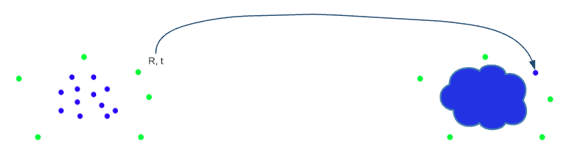
Implementation 2 : Background flow
Modification to ego motion using background flow :
We additionally estimate the background flow.
Estimated ego motion is a weighted average of transform and background flow.
Introduces a new hyperparameter, for now set as 0.5.
Justification:
Ego motion estimation is weak against wrong segmentation.
BG flow brings lower level features and averages out upstream errors.

Slide 9
Implementation 3 : Segmentation Losses
Focal loss
Background points are generally numerous, introducing imbalance.
Less sensitive to class imbalance than CE loss.
Dice loss
Designed to maximize the dice coefficient.
Even less sensitive towards imbalance.
Hard to optimize, because of complicated derivatives.

Slide 10
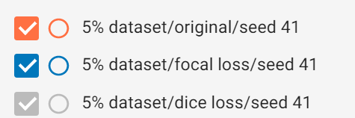
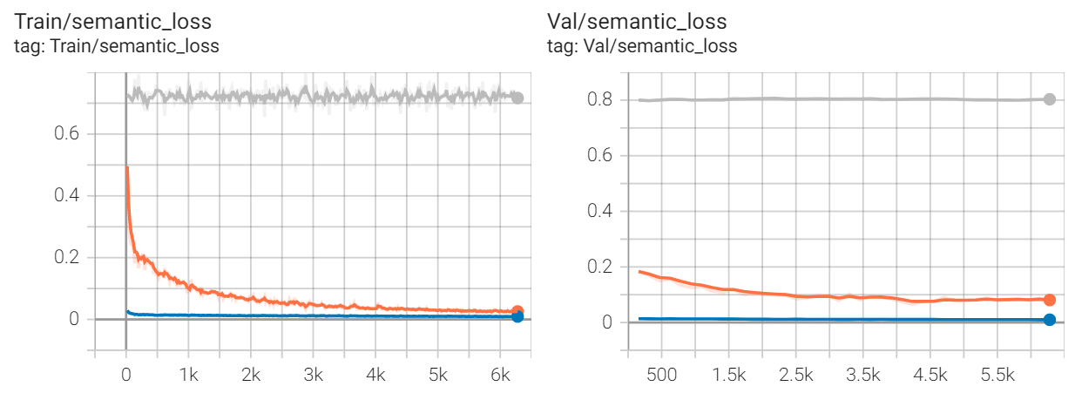
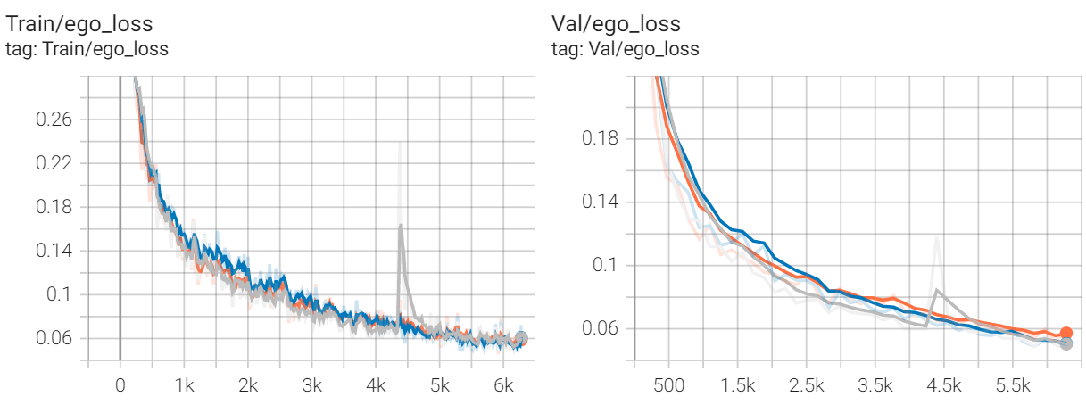
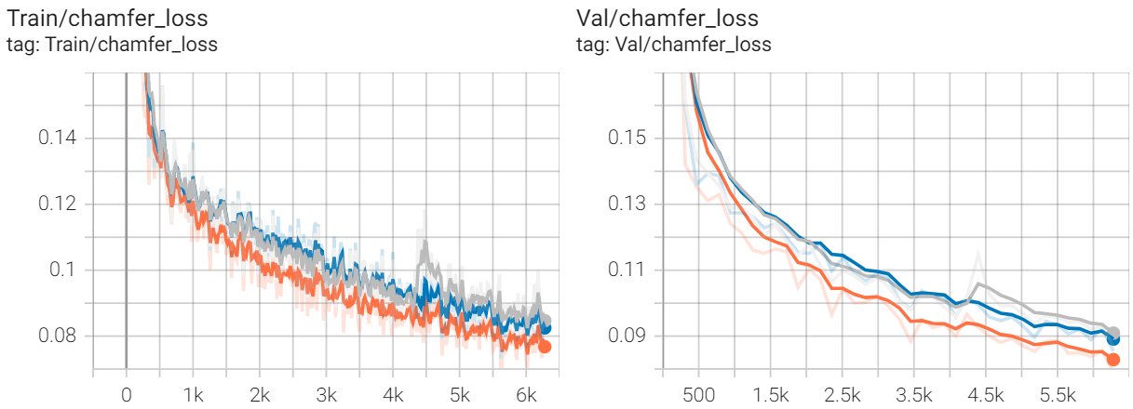
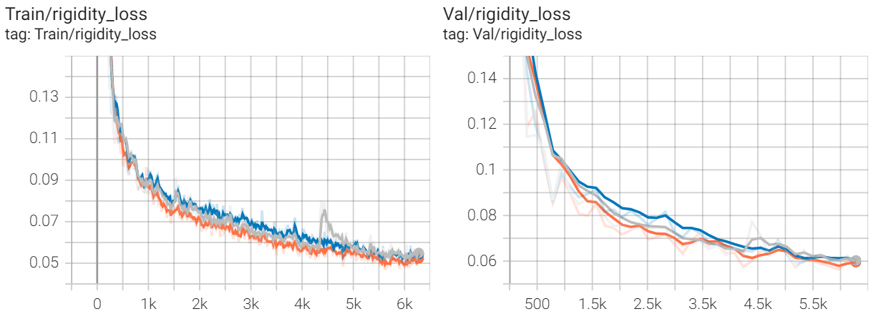
Result of Training (seed 41)

Slide 11
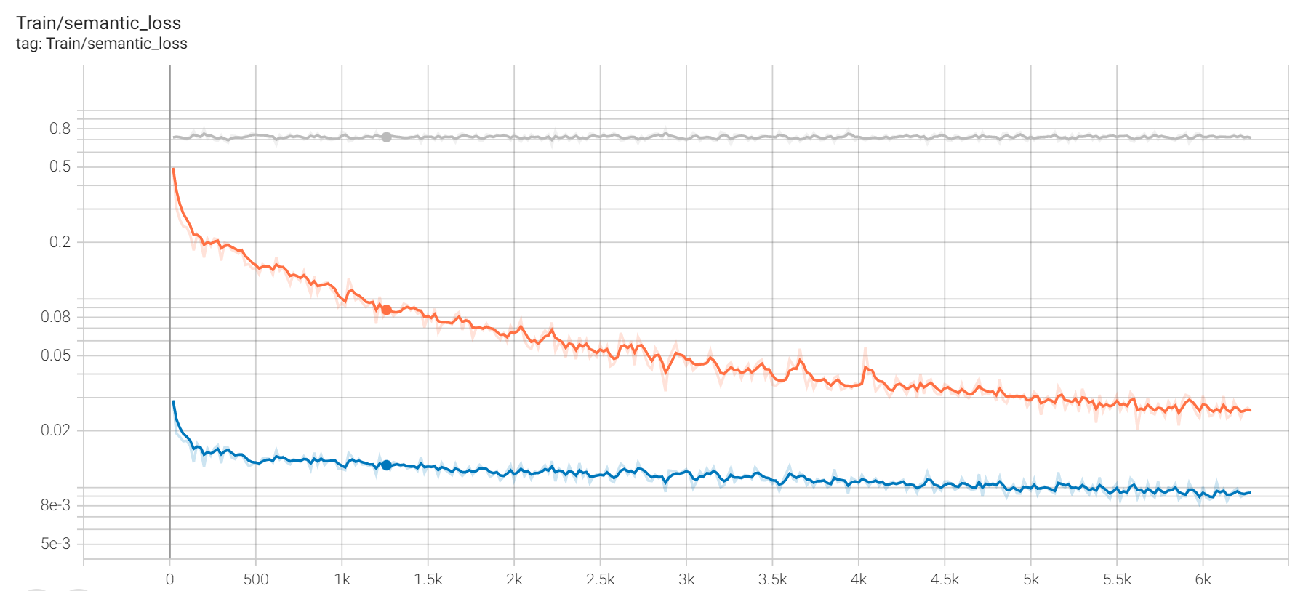
Result of Training (seed 41)

Slide 12
Result of Testing (Seed 41 with 5% dataset)
 | EPE | Acc3DS | ACC3DR | Outlier
Baseline | 0.159 | 0.638 | 0.773 | 0.417
Focal loss | 0.218 | 0.607 | 0.724 | 0.440
Dice loss | 0.285 | 0.443 | 0.570 | 0.615

Slide 13
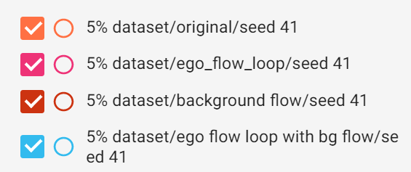
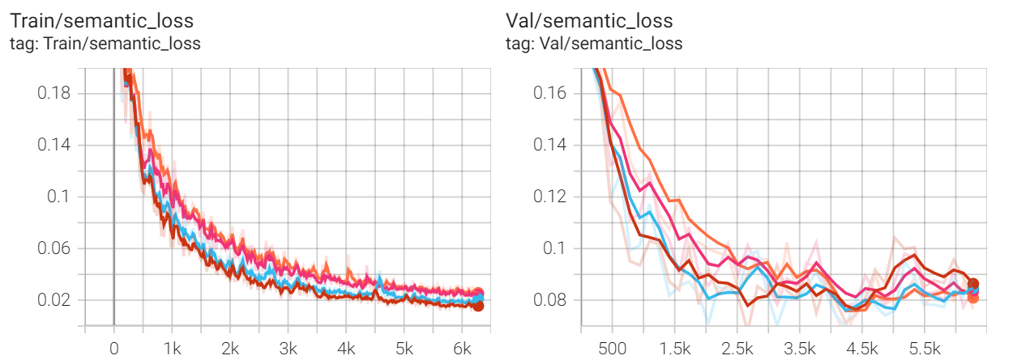
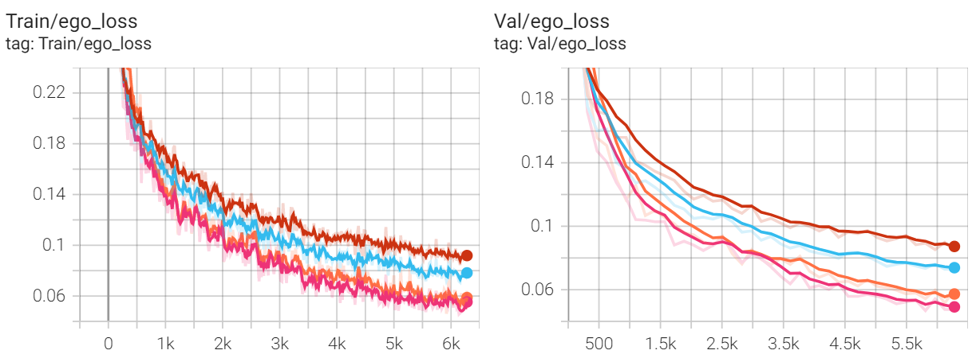
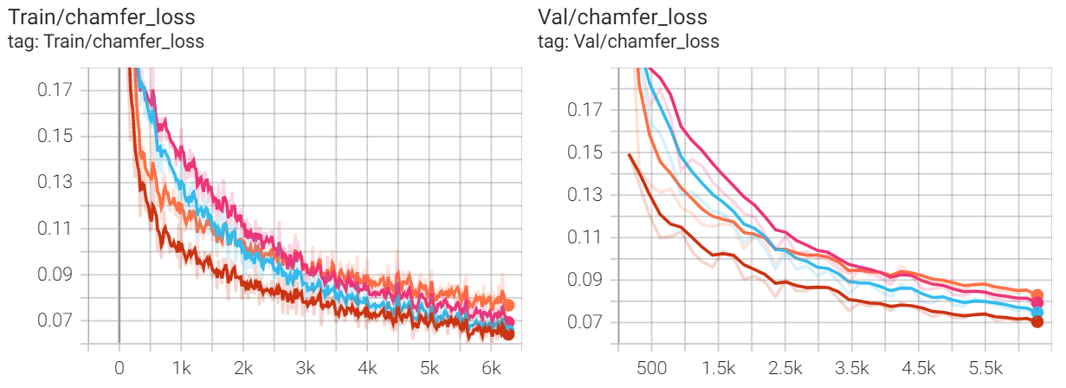
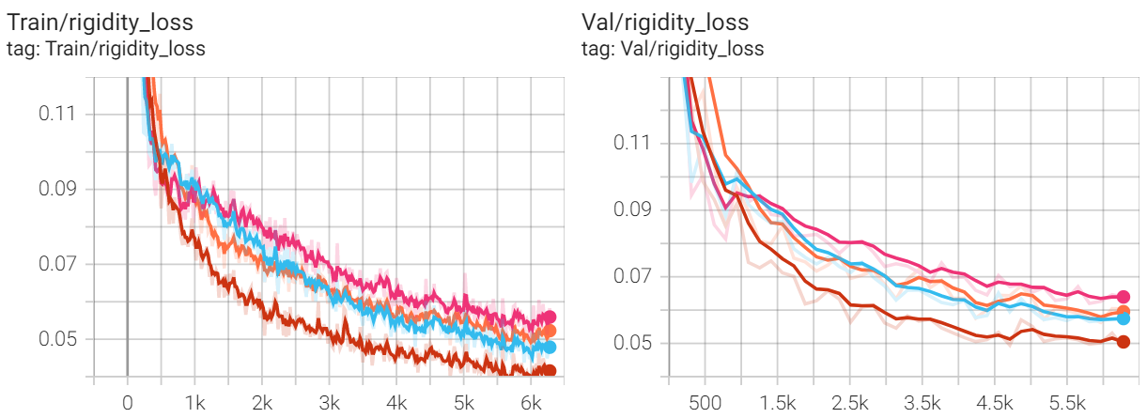
Result of Training (seed 41)

Slide 14
Result of Testing (Seed 41 with 5% dataset)
 | EPE | Acc3DS | ACC3DR | Outlier
Baseline | 0.159 | 0.638 | 0.773 | 0.417
Ego loop | 0.150 | 0.686 | 0.796 | 0.400
Flow loop | 0.145 | 0.670 | 0.789 | 0.421
Ego flow loop | 0.133 | 0.681 | 0.816 | 0.387
Background flow | 0.164 | 0.664 | 0.779 | 0.408
Ego flow loop with background flow | 0.125 | 0.708 | 0.824 | 0.379

Slide 15
Result of Testing (Seed 42 with 5% dataset)
 | EPE | Acc3DS | ACC3DR | Outlier
Baseline | 0.153 | 0.679 | 0.792 | 0.411
Ego flow loop | 0.152 | 0.686 | 0.818 | 0.359
Ego flow loop with background flow | 0.125 | 0.702 | 0.825 | 0.382

Slide 16
Result of Testing (Seed 43 with 5% dataset)
 | EPE | Acc3DS | ACC3DR | Outlier
Baseline | 0.151 | 0.674 | 0.792 | 0.403
Ego flow loop | 0.154 | 0.676 | 0.802 | 0.392
Ego flow loop with background flow | 0.137 | 0.684 | 0.784 | 0.411

Slide 17
Result of Testing
 | EPE | Acc3DS | ACC3DR | Outlier
Baseline (100% training dataset) | 0.094 | 0.784 | 0.885 | 0.314
Ego flow loop with background flow (25% training dataset) | 0.097 | 0.765 | 0.866 | 0.322

Slide 18
Plan until final poster
Experiment our method on a larger dataset
Point cloud visualization supports our approach

Slide 19
Thank you

